Slide 1

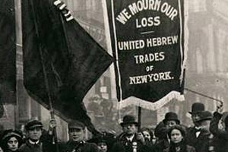
www.MoveToAmend.org ~ signed by 66,468 and counting…

Slide 2
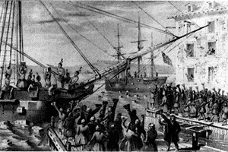
www.MoveToAmend.org ~ signed by 66,468 and counting…

Slide 3
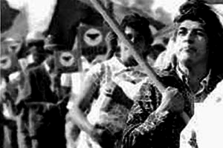
www.MoveToAmend.org ~ signed by 66,468 and counting…

Slide 4
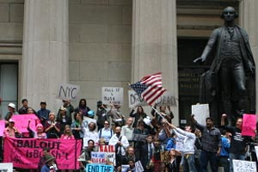
www.MoveToAmend.org ~ signed by 66,468 and counting…

Slide 5
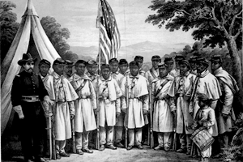
www.MoveToAmend.org ~ signed by 66,468 and counting…

Slide 6
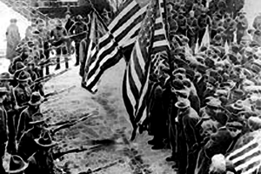
www.MoveToAmend.org ~ signed by 66,468 and counting…

Slide 7
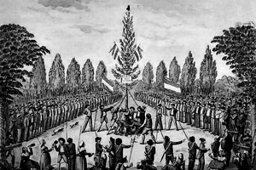
www.MoveToAmend.org ~ signed by 66,468 and counting…

Slide 8
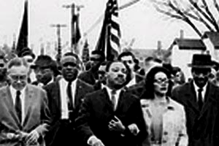
www.MoveToAmend.org ~ signed by 66,468 and counting…

Slide 9
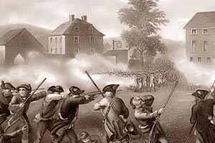
www.MoveToAmend.org ~ signed by 66,468 and counting…

Slide 10
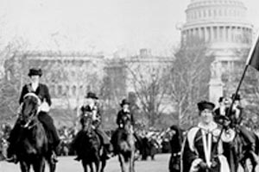
www.MoveToAmend.org ~ signed by 66,468 and counting…

Slide 11
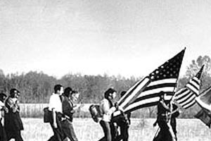
www.MoveToAmend.org ~ signed by 66,468 and counting…

Slide 12
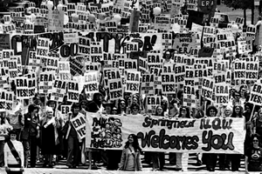
www.MoveToAmend.org ~ signed by 66,468 and counting…

Slide 13
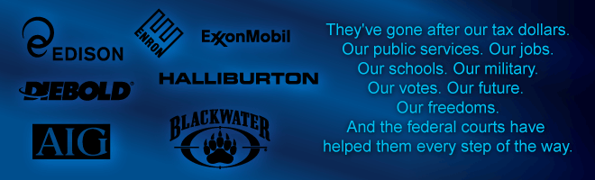
www.MoveToAmend.org
Signed by 66,468
and counting…
On January 21, 2010, with its ruling in Citizens United v. Federal Election Commission, the Supreme Court ruled that corporations are persons, entitled by the U.S. Constitution to buy elections and run our government. Human beings are people; corporations are legal fictions. The Supreme Court is misguided in principle, and wrong on the law. In a democracy, the people rule.
We Move to Amend.
We, the People of the United States of America, reject the U.S. Supreme Court's ruling in Citizens United, and move to amend our Constitution to:
Firmly establish that money is not speech, and that human beings, not corporations, are persons entitled to constitutional rights.
Guarantee the right to vote and to participate, and to have our votes and participation count.
Protect local communities, their economies, and democracies against illegitimate "preemption" actions by global, national, and state governments.

Slide 14
Welcome and thank you for coming!
Introductions
Special thanks to…
    Greenway Partners (Kirk & Steve)
    Mo Hollis, videographer
www.MoveToAmend.org ~ signed by 66,468 and counting…

Slide 15
Assumptions for the Day
Whoever is here today are the right people for this event
Whatever happens is the only thing that could have happened based on the people that come
Whenever we start is the right time to start
Whenever we end, we’re done
www.MoveToAmend.org ~ signed by 66,468 and counting…

Slide 16
Please introduce yourselves…
(1 minute each)
Your name
Why is this issue important to you?
What is the most important question you bring to this meeting?
www.MoveToAmend.org ~ signed by 66,468 and counting…

Slide 17
Today’s Agenda
Presentation
  Citizens United
  Corporate Constitutional Rights (Corporate Personhood)
  Campaign to Legalize Democracy
Question & Answer
Take Action: What Should We Do?
www.MoveToAmend.org ~ signed by 66,468 and counting…
Notes:
Explain participatory process, moving tables, table hosts, etc

Slide 18
Citizens United v. FEC
Overturned McCain Feingold
24 states campaign finance laws now in jeopardy of being overturned as “Unconstitutional”
Legalizes corporate bribery/extortion
Most recent and blatant time the Court has explicitly offered rationale for “Corporate Constitutional Rights” (Corporate Personhood)
www.MoveToAmend.org ~ signed by 66,468 and counting…
Notes:
Explain participatory process, moving tables, table hosts, etc

Slide 19
Definition of “Democracy”
From Greek:
  Demos (the people) + Kratia (power) =
the people rule
www.MoveToAmend.org ~ signed by 66,468 and counting…
Notes:
Explain participatory process, moving tables, table hosts, etc

Slide 20
U.S. Constitution
We the People Government
Free & Sovereign Subordinate & Accountable
Individual Rights Collective Duties
Private Public
CORPORATIONS
www.MoveToAmend.org ~ signed by 66,468 and counting…
Notes:
Pause at public/private and go to timeline before clicking next to bring up red x out

Slide 21
When corporations can legally claim the Constitutional rights of a “person”…
…democracy is illegal!
www.MoveToAmend.org ~ signed by 66,468 and counting…

Slide 22
Campaign to Legalize Democracy in the USA
A New Way Forward
Alliance for Democracy
Black Agenda Report
Center for Media & Democracy
Democracy Unlimited
Detroit Women of Color
Green Institute
Independent Progressive Politics Network
Liberty Tree
National Lawyers Guild
Program on Corporations, Law & Democracy
Reclaim Democracy
Ultimate Civics
Women’s International League for Peace & Freedom
And endorsed by over 60 other organizations.
www.MoveToAmend.org ~ signed by 66,468 and counting…
Notes:
Explain participatory process, moving tables, table hosts, etc

Slide 23
Our Demands
Abolish Corporate Personhood
Establish that money is not speech
Guarantee the right to vote and to participate, and to have our votes and participation count
Protect local communities, their economies, and democracies against control and domination by large corporations
www.MoveToAmend.org ~ signed by 66,468 and counting…
Notes:
Explain participatory process, moving tables, table hosts, etc

Slide 24
Campaign to Legalize Democracy in the USA
Take our inspiration from past social movements
  (American Revolutionaries, Abolitionists, Suffragists, Civil Rights Movement, Second Wave Feminism)
We’re not asking our government, we’re building a movement with ordinary Americans like ourselves – and you!
www.MoveToAmend.org ~ signed by 66,468 and counting…
Notes:
Explain participatory process, moving tables, table hosts, etc

Slide 25
Local Communities are primary actors
4th of July Day of Action: Creative education/street theater
Let our community know about the campaign through art and creativity!
www.MoveToAmend.org ~ signed by 66,468 and counting…
Notes:
Explain participatory process, moving tables, table hosts, etc

Slide 26
Local Communities are primary actors
Politicizing this issue in June 2010 election and beyond
Candidate survey published to press
Bird-dogging candidates to take position
Running people for office ourselves
www.MoveToAmend.org ~ signed by 66,468 and counting…
Notes:
Explain participatory process, moving tables, table hosts, etc

Slide 27
Local Communities are primary actors
Municipal Civil Disobedience
Passing City/County Resolutions in support of campaign
Local Ordinance(s) calling for Amendment and outlawing Corporate Personhood in Humboldt County
www.MoveToAmend.org ~ signed by 66,468 and counting…

Slide 28
Discussion:
What stood out for you in the presentation (on both Corporate Personhood
and the Campaign)?
What are your questions?
www.MoveToAmend.org ~ signed by 66,468 and counting…

Slide 29
Conversation Guidelines
  Listen as if your life depended on it
  Speak to what matters to you (succinctly)
  Share “air time”
  Let people finish their thoughts (i.e., do not interrupt)
  Encourage everyone to contribute
www.MoveToAmend.org ~ signed by 66,468 and counting…
Notes:
Explain participatory process, moving tables, table hosts, etc

Slide 30
Please move to a different table
(with different people)
www.MoveToAmend.org ~ signed by 66,468 and counting…

Slide 31
Discussion:
Drawing on inspiration from the social movement that speaks to you most, what do you think we should do – in Humboldt County and across the country – to win this campaign and legalize democracy in the United States of America?
www.MoveToAmend.org ~ signed by 66,468 and counting…

Slide 32
Break Out Groups:
Develop action plan proposal to move your tactic forward…
30 minutes
www.MoveToAmend.org ~ signed by 66,468 and counting…

Slide 33
Next Steps…
Join Democracy Unlimited for pancakes every 3rd Sunday: 10am-noon at the Duck House in Eureka (1402 M Street) - $5 Community Currency
Democracy Unlimited Office Hours:
    Mondays (10:30am-1pm)
    Tuesdays (4:30-8pm)
    Wednesdays (2:30-6pm)
    Thursdays (12:30-4pm)
www.MoveToAmend.org ~ signed by 66,468 and counting…

Slide 34
Next Steps…
Working groups?
Sign the Petition at www.MoveToAmend.org
Tell your friends!
www.MoveToAmend.org ~ signed by 66,468 and counting…

Slide 35
Democracy Unlimited
www.DUHC.org
(707) 269-0984
“The Duck House/Democray Unlimited” on Facebook
Campaign to Legalize Democracy
www.MoveToAmend.org
“Move to Amend” on Facebook
www.MoveToAmend.org ~ signed by 66,468 and counting…

